Slide 1
openai-dotnet: The official OpenAI library for .NET
Scott Addie
Principal Product Manager, Azure SDK for .NET

Slide 2
Agenda
Introduction
What is openai-dotnet and who is building it?
What are its capabilities?
Demos
Resources and how to get involved
Q&A

Slide 3
01
What is openai-dotnet and who is building it?

Slide 4
.NET developer pain points
Unfamiliar ecosystems
REST APIs
No SLAs
Python or Node.js
Custom wrappers
Risk aversion

Slide 5
openai-dotnet is… the official OpenAI library for .NET, built by Microsoft, on behalf of OpenAI

Slide 6
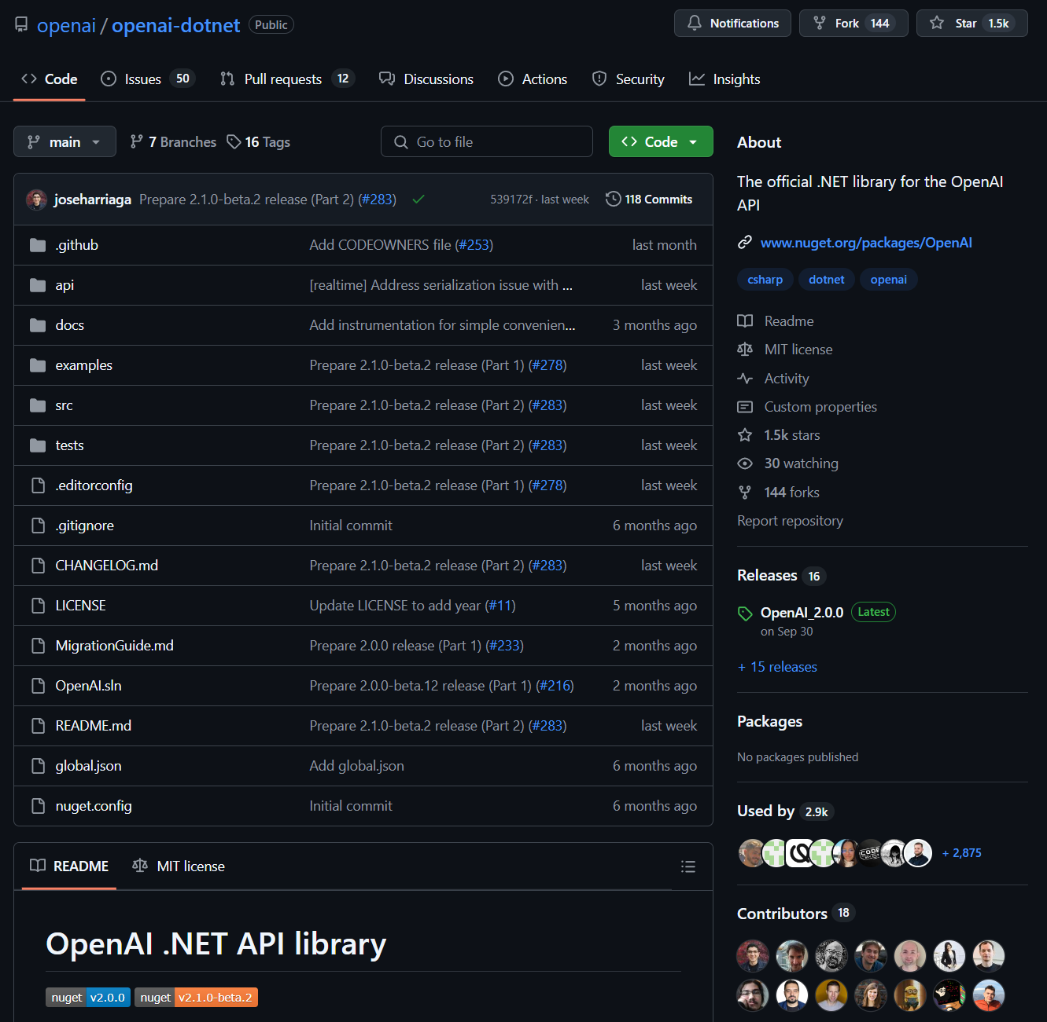
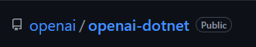

What does this mean in practice?
It means that the repo is under the OpenAI GitHub org, because they own it (and the same goes for the NuGet package).
The contributors to the repo though are Microsoft employees building the library in the open.
https://github.com/openai/openai-dotnet

Slide 7
02
What are its capabilities?

Slide 8
Benefits of using the official library
Complete coverage of the OpenAI REST API
Support for the latest OpenAI models
The full gamut of OpenAI’s REST API is supported today, including the recently released Realtime API for which we had support on the same day it was publicly announced.
OpenAI’s latest flagship models, including GPT-4o, GPT-4o mini, o1-preview, and o1-mini, are fully supported today. Moving forward, our goal is to provide access to the very latest models as soon as they’re publicly available.
Idiomatic and productive
Extensible
Designed to be intuitive and efficient for C# developers, optimized for real-world tasks. It provides seamless integration with OpenAI's latest features, allowing developers to build intelligent applications with ease and efficiency.
Designed with extensibility in mind, allowing the community to build additional libraries on top of it.

Slide 9
03
Demos: Realtime API for audio

Slide 10
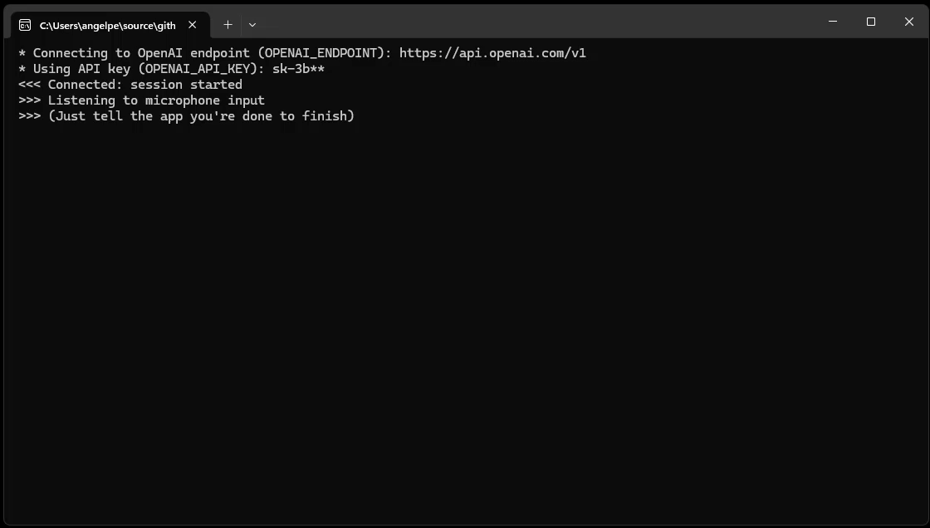
Demo: Realtime API for audio

Slide 11
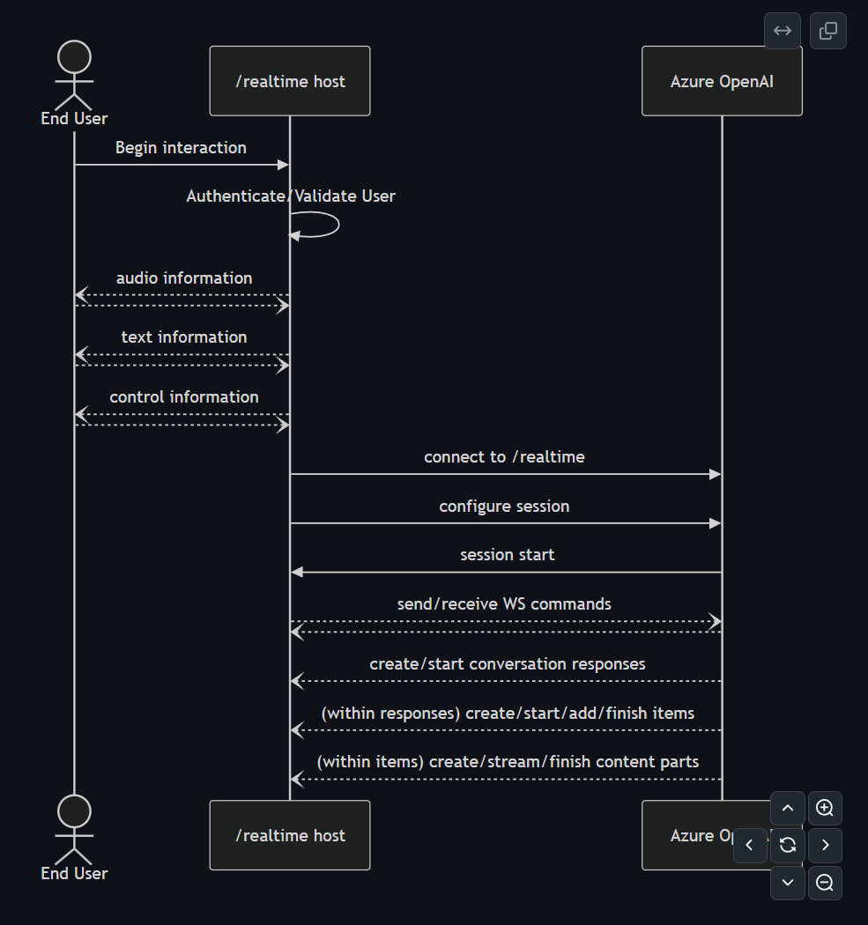
Realtime API interactions
Using the Azure OpenAI library for .NET

Slide 12
04
Resources and how to get involved

Slide 13




Resources
https://github.com/openai/openai-dotnet
https://aka.ms/azsdk/openai
Official OpenAI GitHub repo
Companion Azure library source code
https://github.com/Azure-Samples/aoai-realtime-audio-sdk
https://github.com/robch/openai-realtime-chat-with-keyword-cs
Sample code for Realtime API for audio demo
Sample code for Realtime API for audio demo
https://aka.ms/openai/feature-request
https://aka.ms/azsdk/feature-request
Feature requests for the official OpenAI library
Feature requests for the companion Azure library
https://aka.ms/openai/bug-report
https://aka.ms/azsdk/bug-report
Support for the official OpenAI library
Support for the companion Azure library

Slide 14
05
Q&A

Slide 15
Thank you

Slide 16

Get .NET 9
Download .NET 9 aka.ms/get-dotnet-9

